Slide 1
HomeWork1
By: Wihar Paladugula

Slide 2
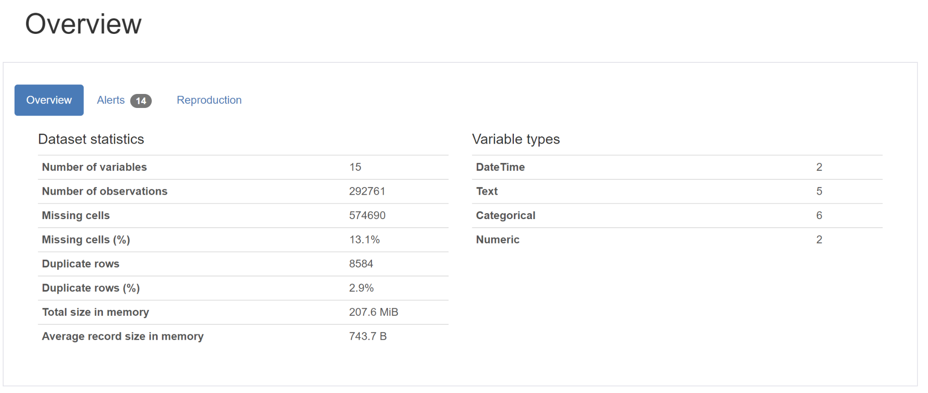
Dataset profile table to get an overview of the dataset
There are some duplicate rows which can be dropped.
There are 2 DateTime, 5 Text, 6 Categorical, 2 Numeric columns.

Slide 3
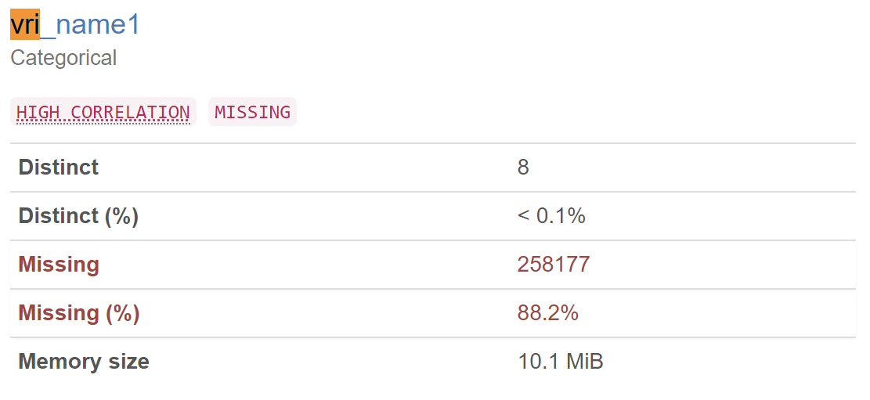
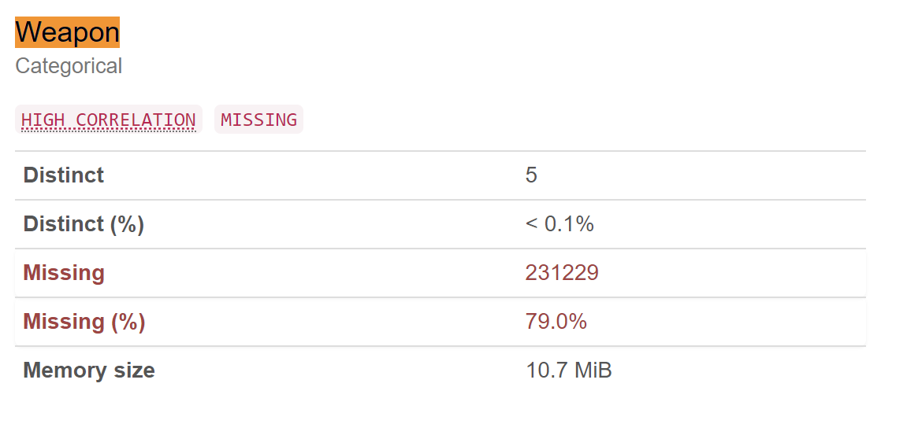
Profile table - missing data
88.2% of the column ‘vri_name1’ data is missing
79.2% of column ‘Weapon’ data is missing.
“This suggest that the data collection process is incomplete”.

Slide 4
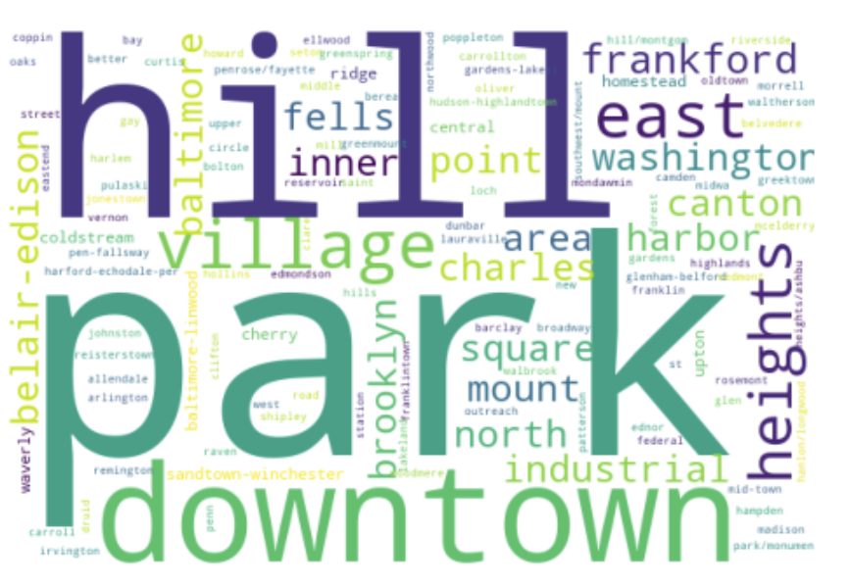
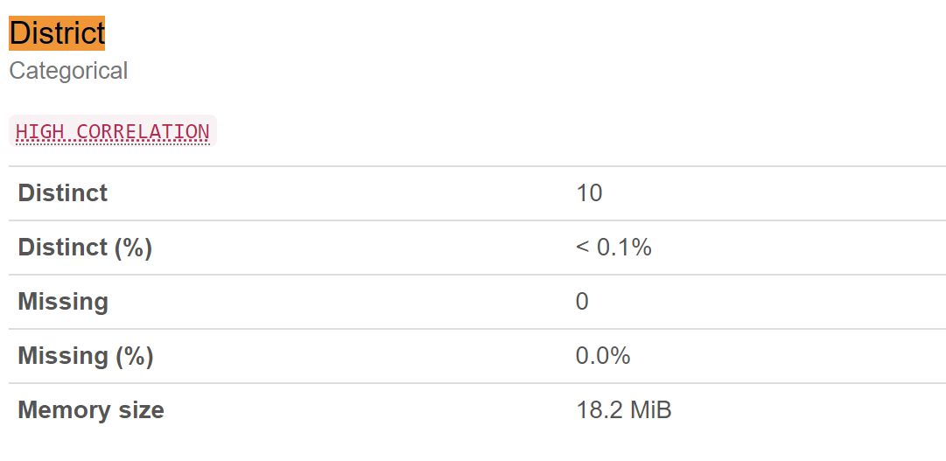
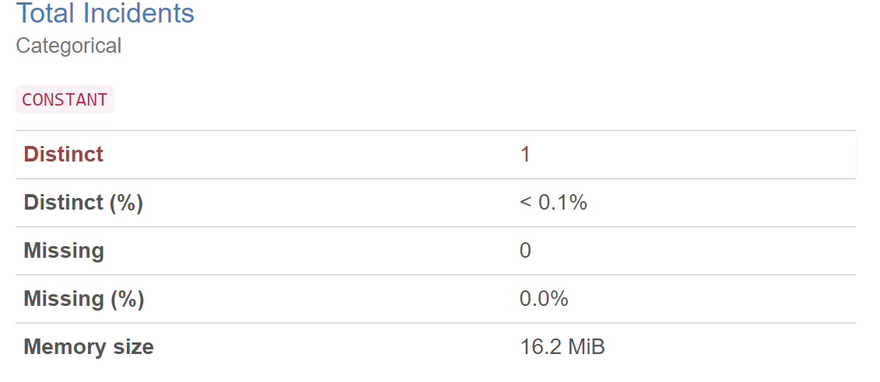

Slide 5
The presence of free text in the "Description" column makes it difficult to analyze the data using traditional machine learning techniques.
The "District" column has a 10 unique values. This suggests that the city is divided into 10 police districts.
Most crimes are around downtown and surrounding "Neighborhood" 's.
There is only one unique value in 'Total Incidents' i.e 1 hence count of rows give total crimes.

Slide 6
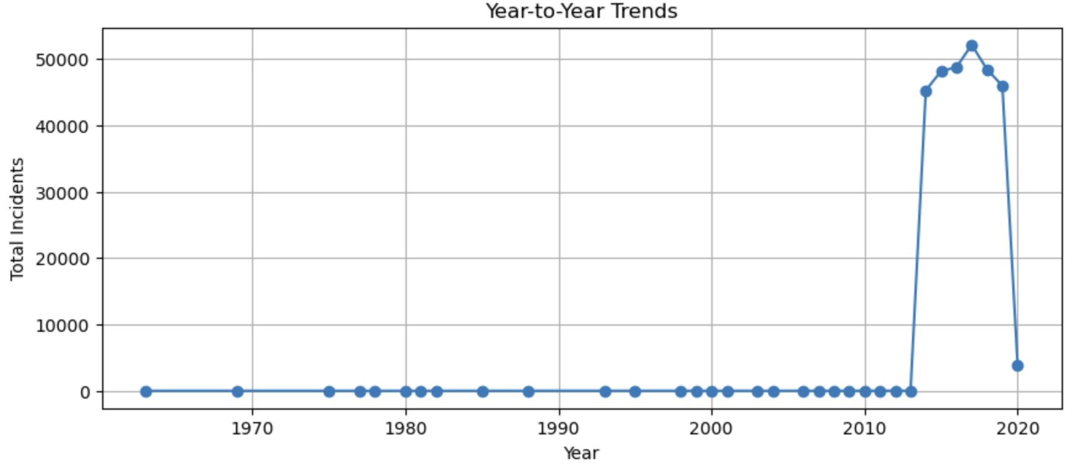
Year-to-Year trend of the overall crime incidence aggregating from all geo-locations
There is crime data from 1950’s to 2020.
But data collection seems to be incomplete since the number crimes recorded before 2020 are minimal.
Also, data is collected upto mid of 2020.

Slide 7
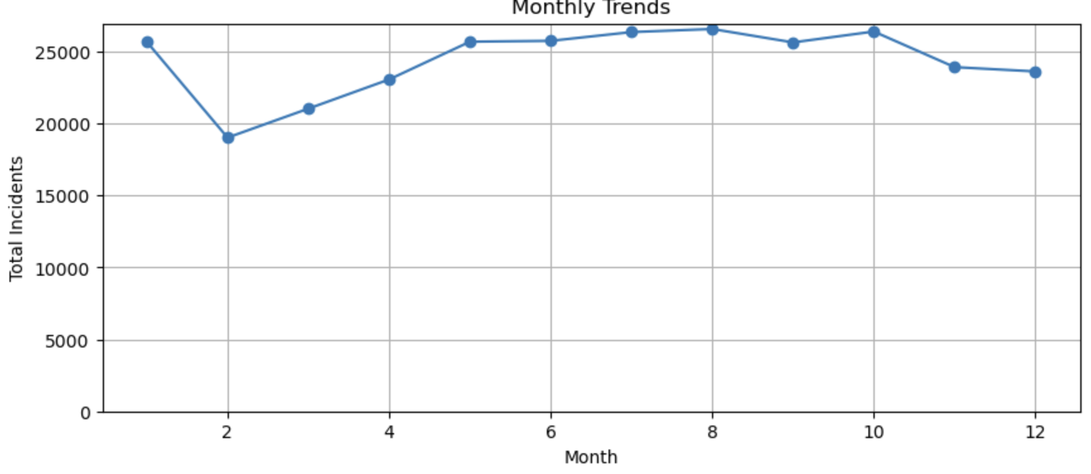
Month-to-Month trend of the overall crime incidence aggregating from all geo-locations
There is a similar number of crimes throughout the months.
One thing to observe is there is a slight dip in number of crimes around February.

Slide 8
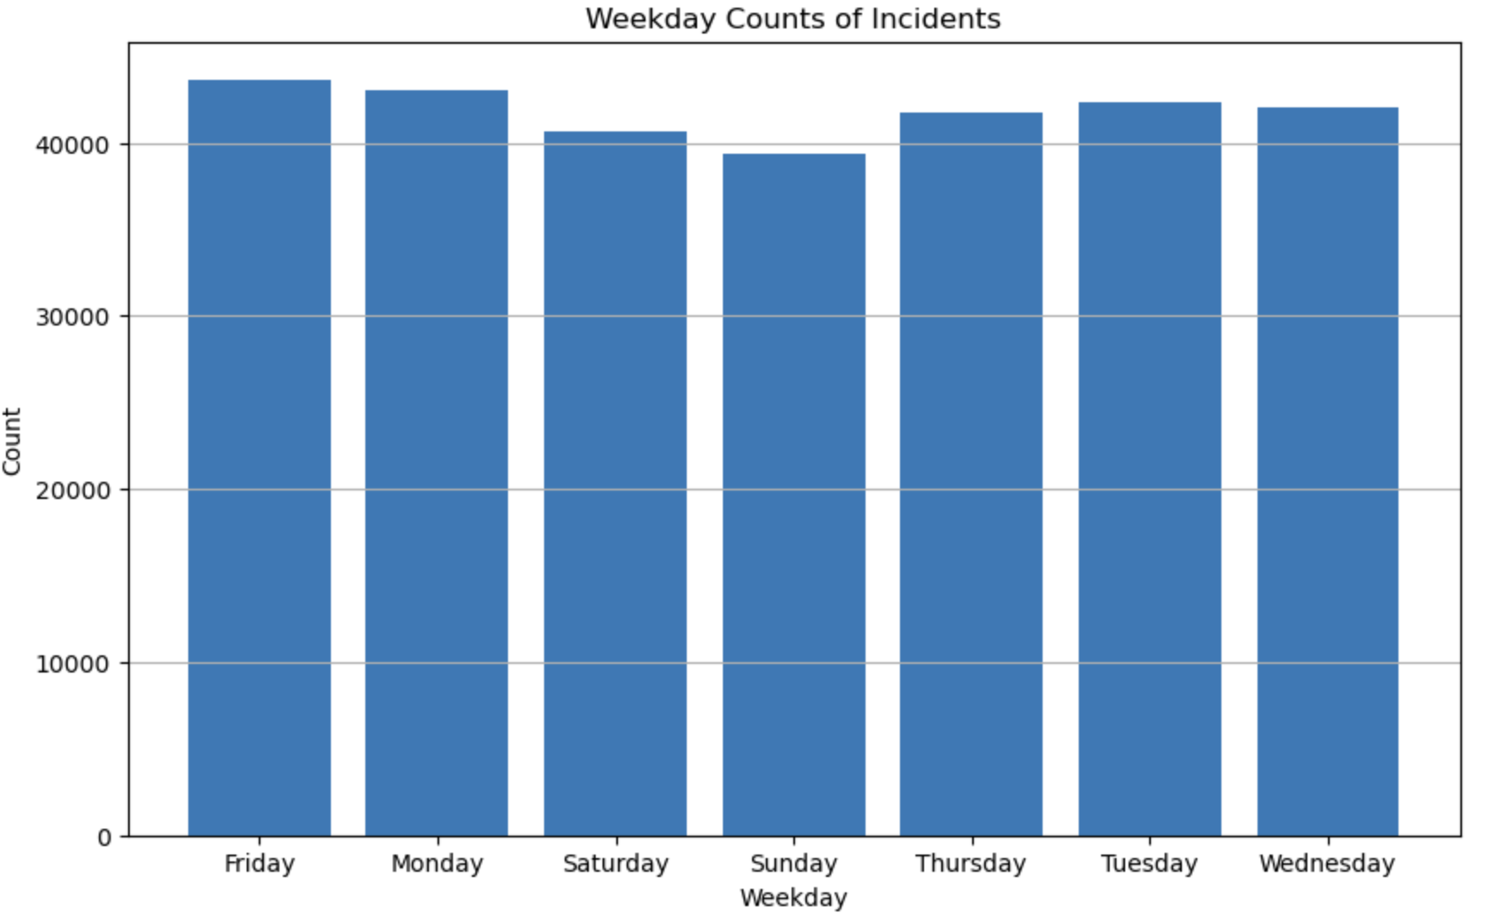
Weekday trend of the overall crime incidence aggregating from all geo-locations
There is a similar number of crimes throughout the weekdays.
But there is a slight dip in number of crimes in the weekend.

Slide 9
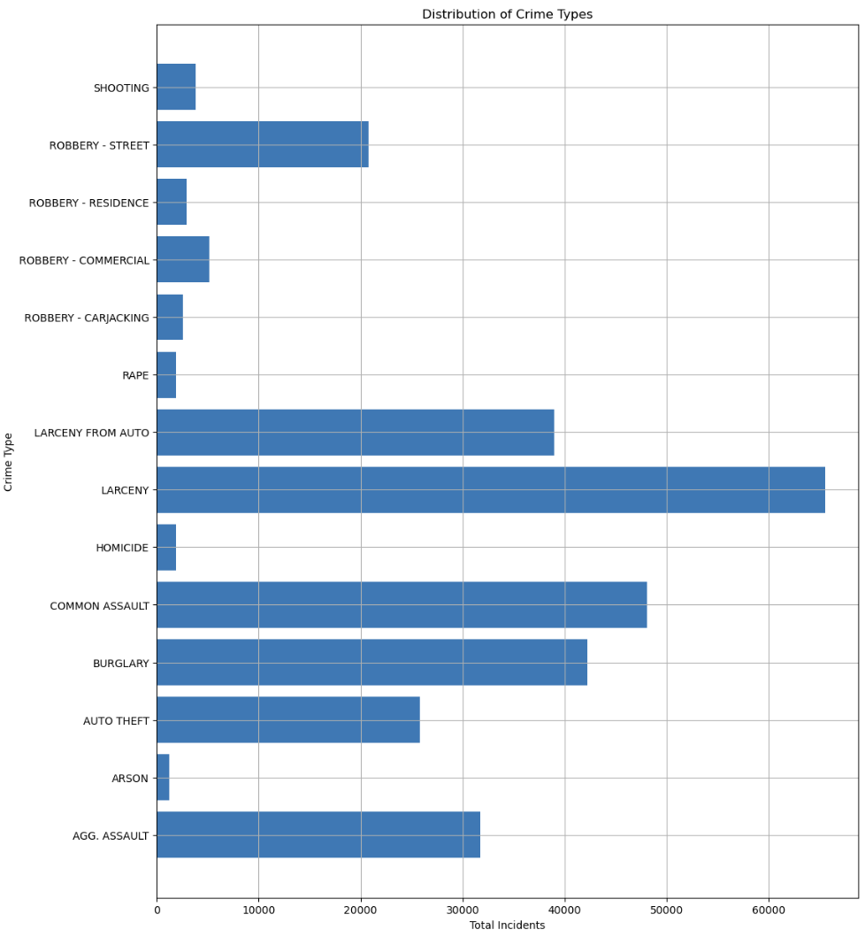
Plot describing the distribution of crime type aggregating from all geo-locations and all time periods.
Larceny was the most recorded crime.
Arson was the least recorded crime.

Slide 10
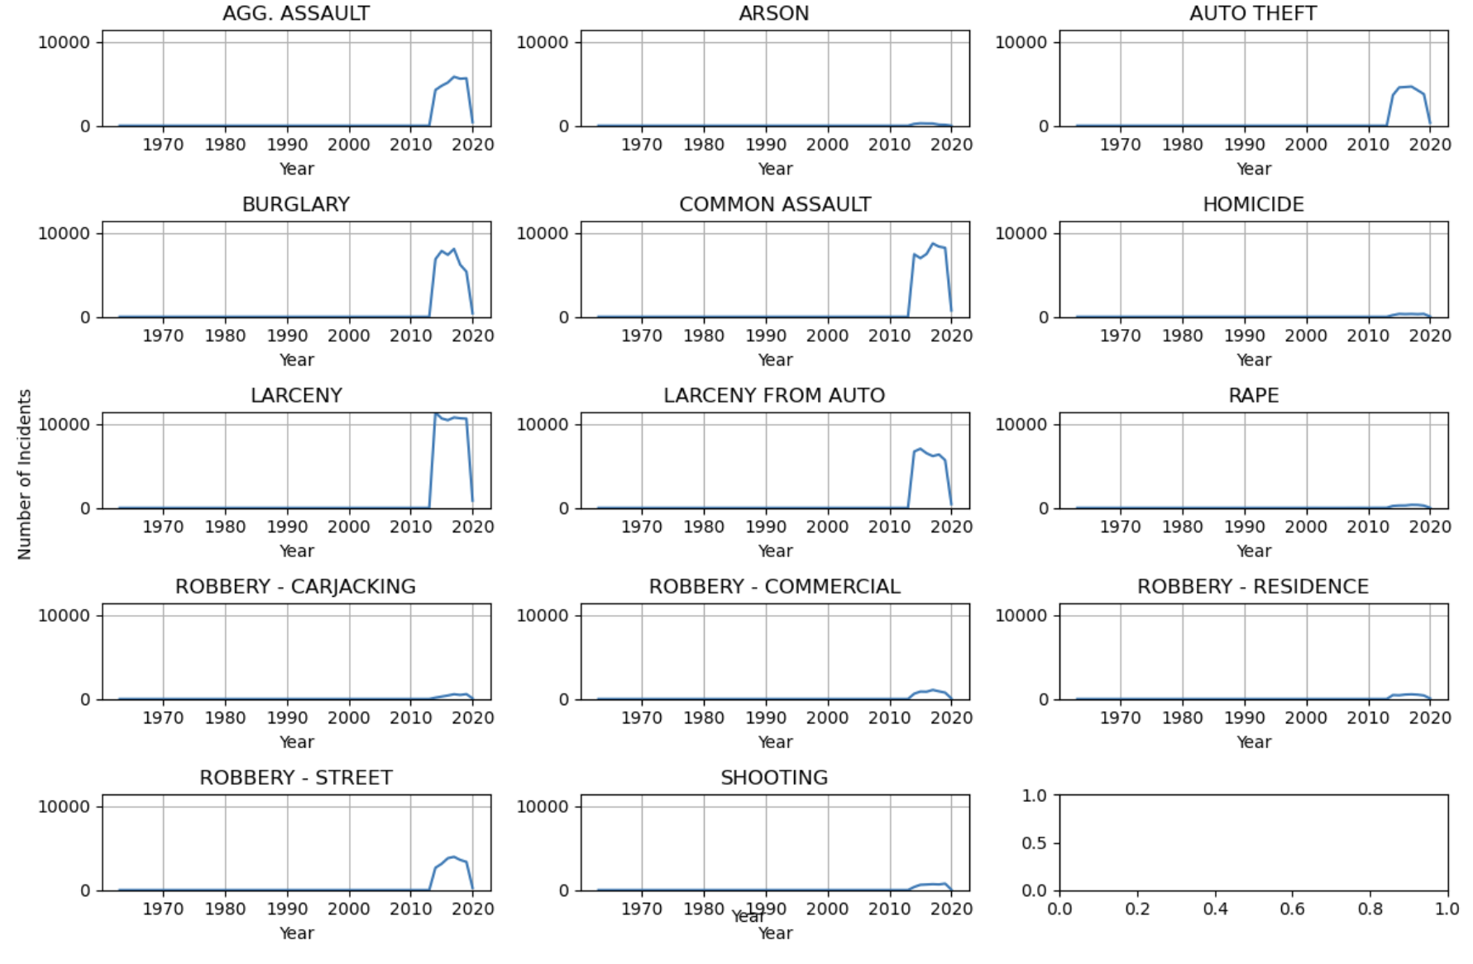
Crime type distributions of year to year aggregating across all locations.
The above plot shows year by year crime type trend. We can observe Larceny is the most recorded crime.

Slide 11
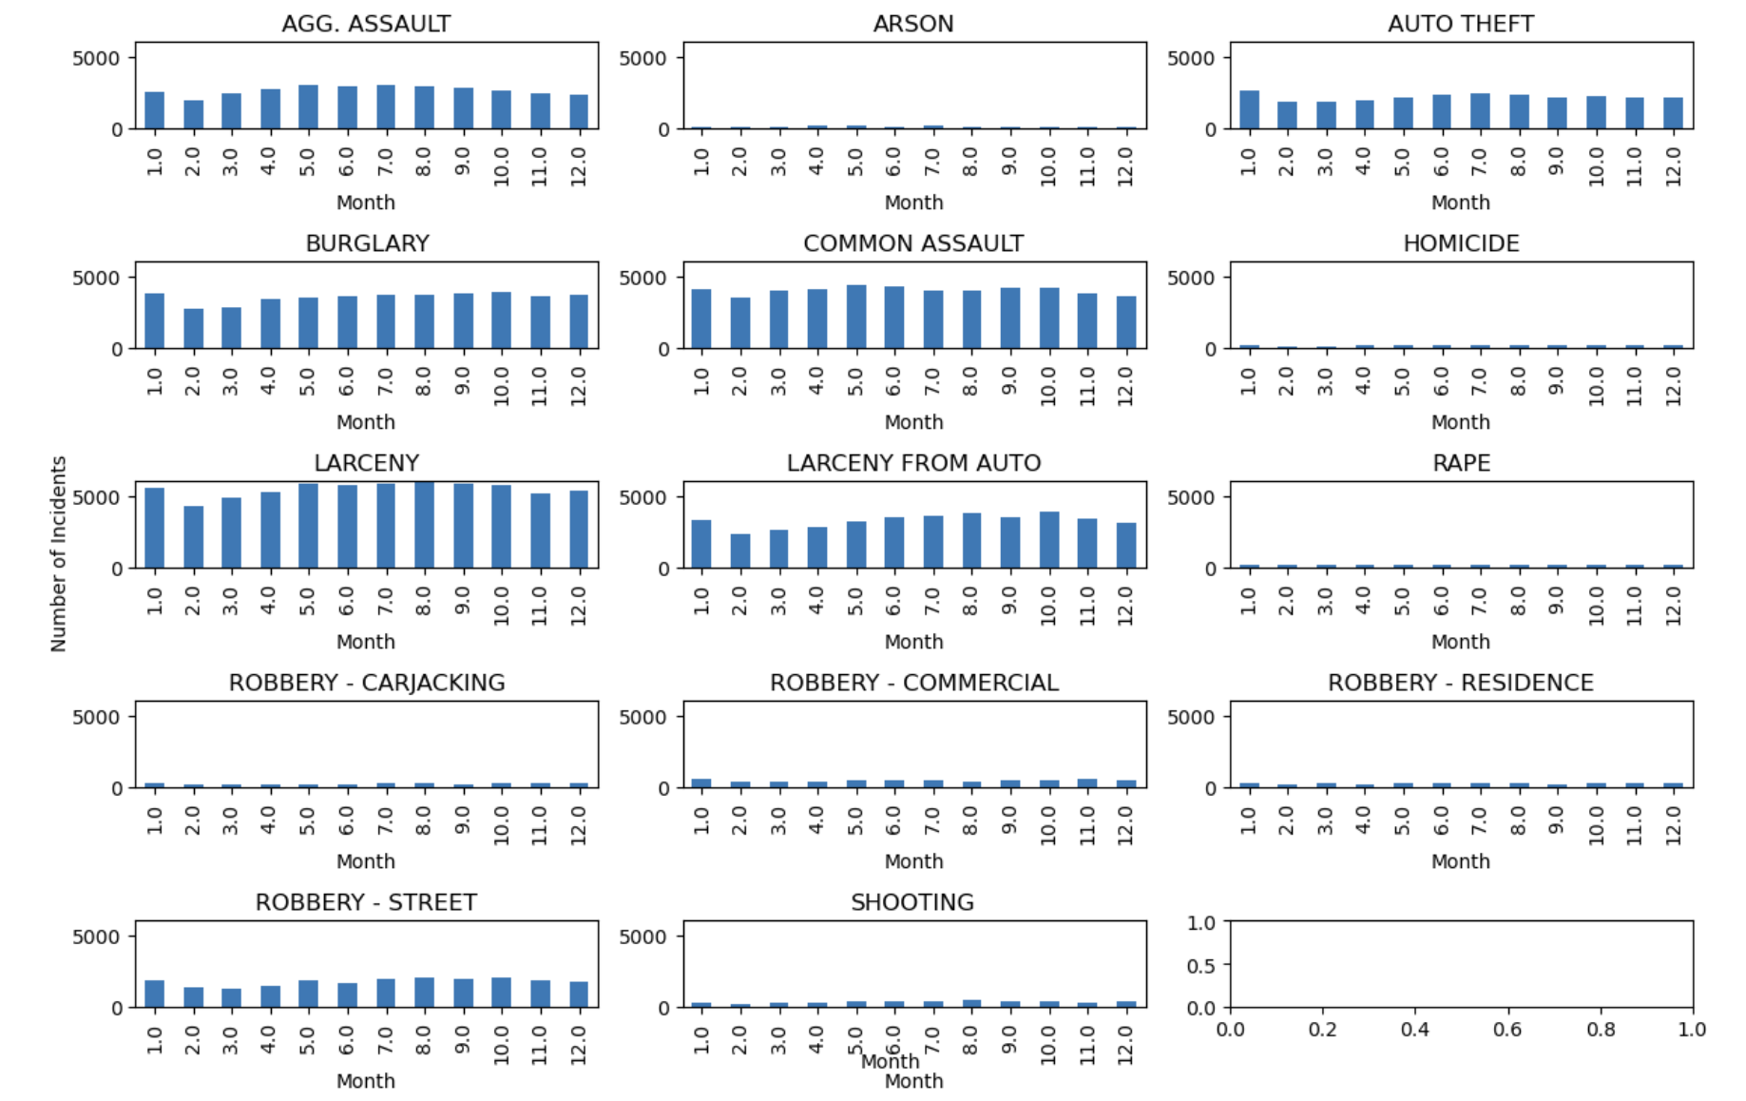
Crime type distributions of month to month aggregating across all locations.
The above plot shows month by month crime type trend. We can observe Larceny is the most recorded crime. And the distribution of crimes is same across all months.

Slide 12
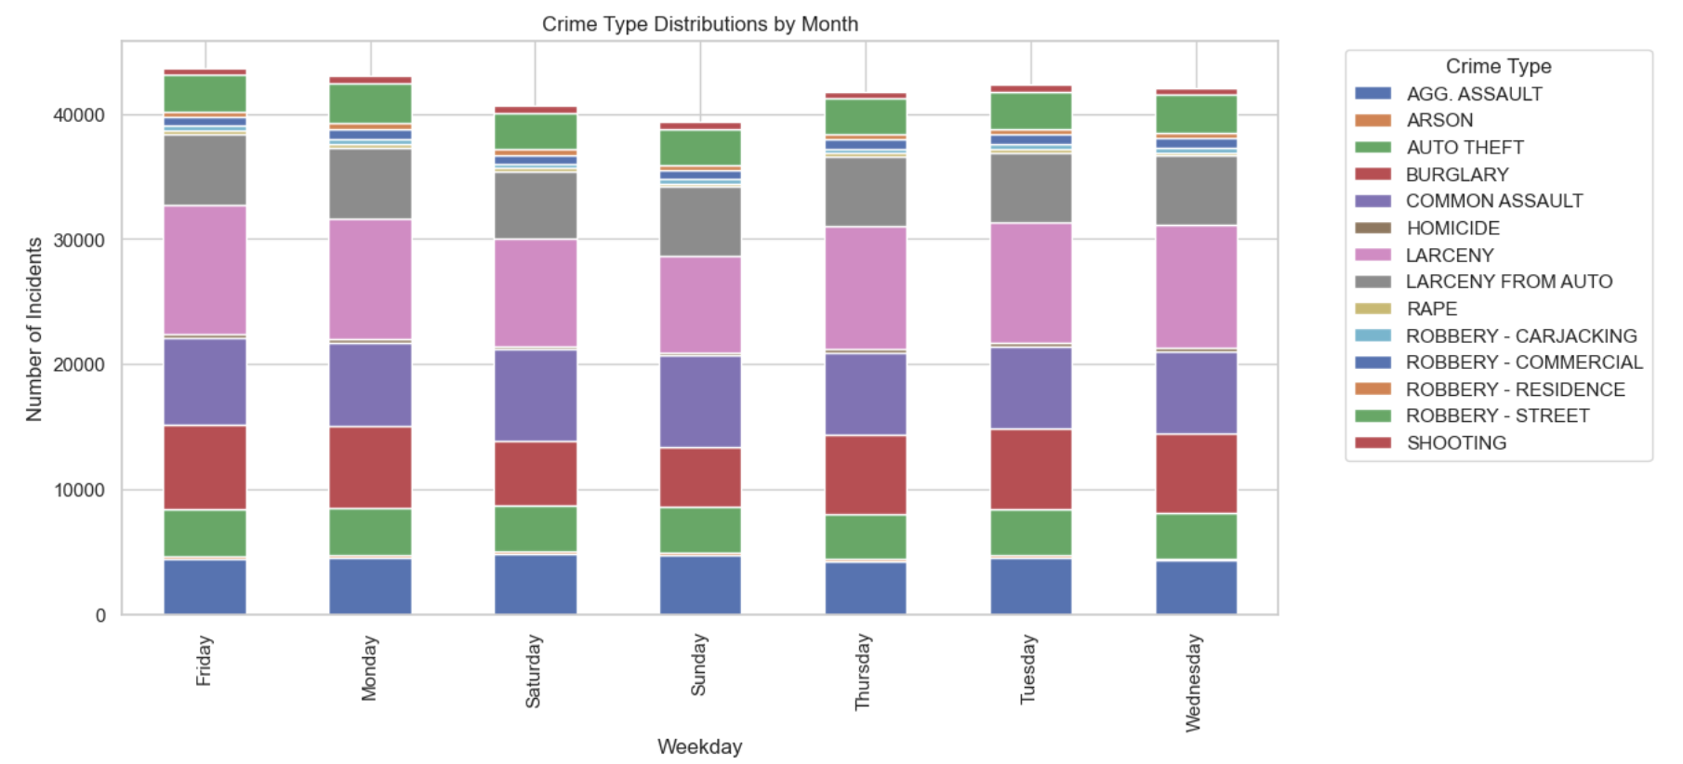
Crime type distributions of weekdays aggregating across all locations.
The plot shows week-day crime type trend. We can observe Larceny is the most recorded crime. And the distribution of crimes is same across all days.

Slide 13
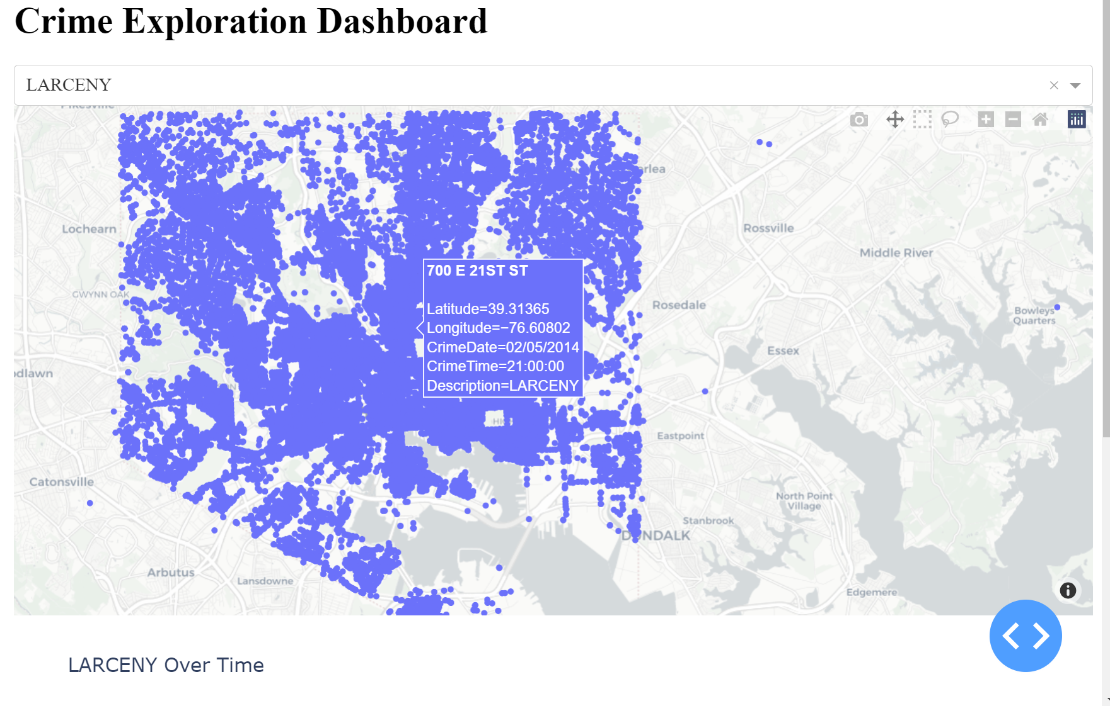
Dashboard that allows users like Gary to explore the spatial and temporal patterns of crime.
The dashboard shows map for each crimetype in the city.
User has the ability to choose the crime type.
It also shows crime over time.

Slide 14
Thank you

